Slide 1
COMP 2230
Week 10 - Wednesday

Slide 2
Last time
Independent events
Introduction to graphs

Slide 3
Questions?

Slide 4
Assignment 5

Slide 5
Logical warmup
You work in a pizzeria, and it's a busy night
You forgot that there was already a pizza in the oven, and you throw a second, identical pizza in
The huge oven is built for many pizzas, but the new pizza lands partially on top of the first one
What's the probability that the center of the top pizza is directly over the bottom pizza instead of over the bare oven surface?

Slide 6
Paths and Circuits

Slide 7
Euler circuits
What if you want to find an Euler circuit of your own?
If a graph is connected, non-empty, and every node in the graph has even degree, the graph has an Euler circuit
Algorithm to find one:
Pick an arbitrary starting vertex
Move to an adjacent vertex and remove the edge you cross from the graph
Whenever you choose such a vertex, pick an edge that will not disconnect the graph
If there are still uncrossed edges, go back to Step 2

Slide 8


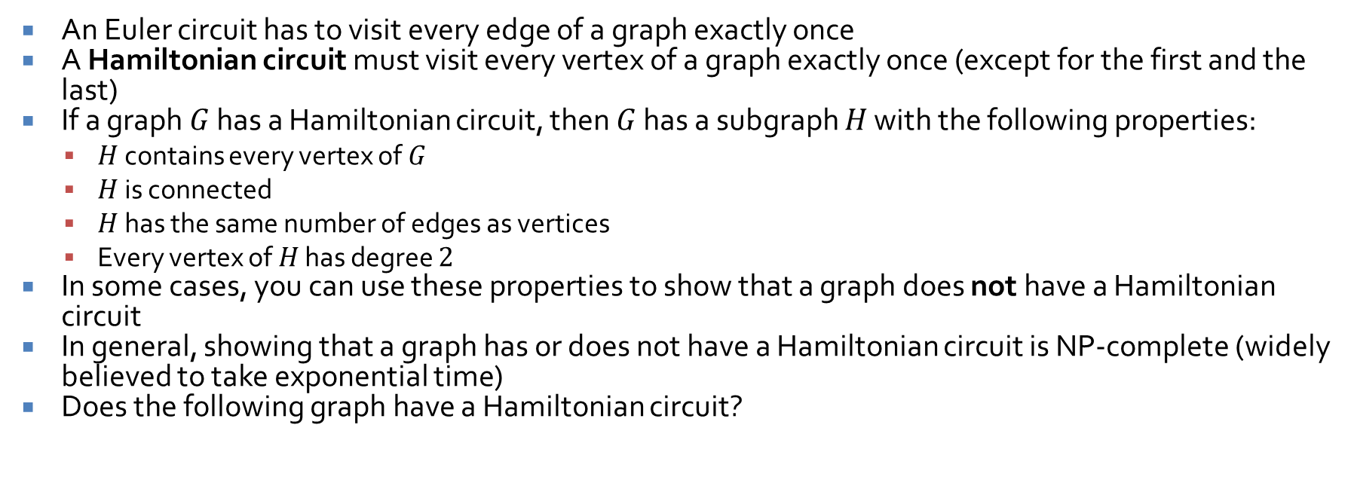



Hamiltonian circuits
An Euler circuit has to visit every edge of a graph exactly once
A Hamiltonian circuit must visit every vertex of a graph exactly once (except for the first and the last)
If a graph $G$ has a Hamiltonian circuit, then $G$ has a subgraph $H$ with the following properties:
$H$ contains every vertex of $G$
$H$ is connected
$H$ has the same number of edges as vertices
Every vertex of $H$ has degree $2$
In some cases, you can use these properties to show that a graph does not have a Hamiltonian circuit
In general, showing that a graph has or does not have a Hamiltonian circuit is NP-complete (widely believed to take exponential time)
Does the following graph have a Hamiltonian circuit?
$$a$$
$$c$$
$$b$$
$$e$$
$$d$$

Slide 9
Matrix Representations of Graphs and Isomorphism
Three-Sentence Summary

Slide 10
Matrix Representations of Graphs

Slide 11


Matrices
As you presumably know, a matrix is a rectangular array of elements
An $m×n$ matrix has $m$ rows and $n$ columns
$$A=\left[\begin{matrix}\begin{matrix}a_{11} & a_{12} & ⋯ \\ a_{21} & a_{22} & ⋯ \\ ⋮ & ⋮ & \end{matrix} & \begin{matrix}a_{1j} & ⋯ & a_{1n} \\ a_{2j} & ⋯ & a_{2n} \\ ⋮ & & ⋮\end{matrix} \\ \begin{matrix}a_{i1} & a_{i2} & ⋯ \\ ⋮ & ⋮ & \\ a_{m1} & a_{m2} & ⋯\end{matrix} & \begin{matrix}a_{ij} & ⋯ & a_{in} \\ ⋮ & ⋯ & ⋮ \\ a_{mj} & ⋯ & a_{mn}\end{matrix}\end{matrix}\right]$$

Slide 12
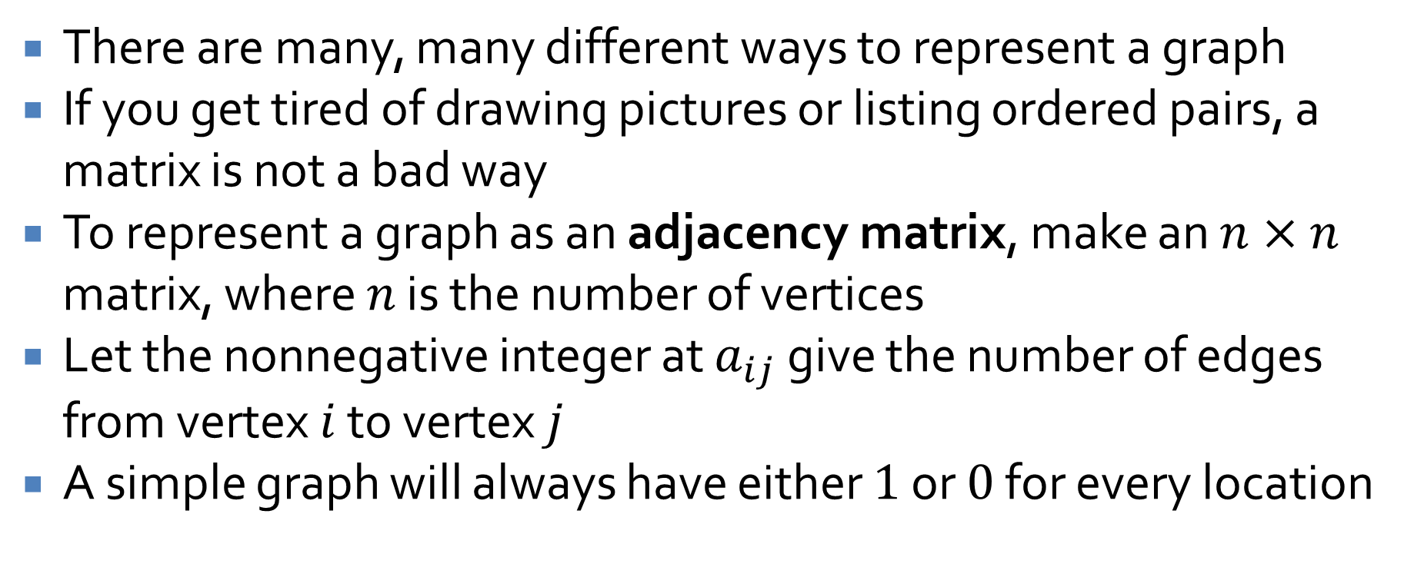
Graph representations
There are many, many different ways to represent a graph
If you get tired of drawing pictures or listing ordered pairs, a matrix is not a bad way
To represent a graph as an adjacency matrix, make an $n×n$ matrix, where $n$ is the number of vertices
Let the nonnegative integer at $a_{ij}$ give the number of edges from vertex $i$ to vertex $j$
A simple graph will always have either $1$ or $0$ for every location

Slide 13






Graph to matrix examples
What is the adjacency matrix for the following graph?
What about for this one?
$$v_{1}$$
$$v_{2}$$
$$v_{3}$$
$$v_{3}$$
$$v_{1}$$
$$v_{2}$$

Slide 14

Matrix to graph example
Draw a graph corresponding to this matrix:
$$A=\left[\begin{matrix}0 & 1 & 1 & 0 \\ 1 & 1 & 0 & 2 \\ 0 & 0 & 1 & 1 \\ 2 & 1 & 0 & 0\end{matrix}\right]$$

Slide 15





Another graph to matrix
What's the adjacency matrix of this graph?
Note that the matrix is symmetric
In a symmetric matrix, $a_{ij} = a_{ji}$ for all $1≤i≤n$ and $1≤j≤n$
All undirected graphs have a symmetric matrix representation
$$v_{1}$$
$$v_{2}$$
$$v_{4}$$
$$v_{3}$$

Slide 16
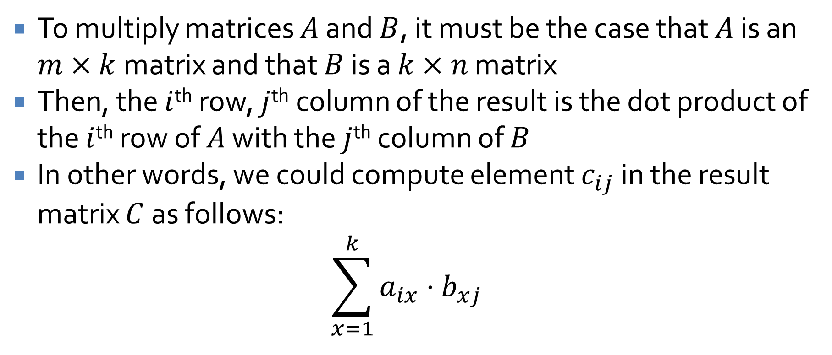
Matrix multiplications
To multiply matrices $A$ and $B$, it must be the case that $A$ is an $m×k$matrix and that $B$ is a $k×n$ matrix
Then, the $i$^{th} row, $j$^{th} column of the result is the dot product of the $i$^{th} row of $A$ with the $j$^{th} column of $B$
In other words, we could compute element $c_{ij}$ in the result matrix $C$ as follows:
$$\sum_{x=1}^{k}{a_{ix}⋅b_{xj}}$$

Slide 17

Matrix multiplication practice
Multiply matrices $A$ and $B$
$$A=\left[\begin{matrix}2 & 0 & 3 \\ −1 & 1 & 0\end{matrix}\right]$$
$$B=\left[\begin{matrix}4 & 3 \\ 2 & 2 \\ −2 & −1\end{matrix}\right]$$

Slide 18
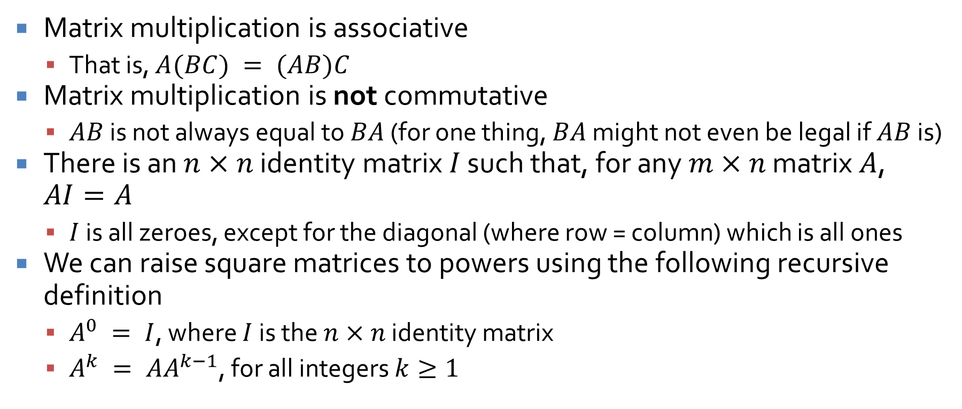
A few points about matrix multiplication
Matrix multiplication is associative
That is, $A(BC) = (AB)C$
Matrix multiplication is not commutative
$AB$ is not always equal to $BA$ (for one thing, $BA$ might not even be legal if $AB$ is)
There is an $n×n$ identity matrix $I$ such that, for any $m×n$ matrix $A$, $AI=A$
$I$ is all zeroes, except for the diagonal (where row = column) which is all ones
We can raise square matrices to powers using the following recursive definition
$A^{0} = I$, where $I$ is the $n×n$ identity matrix
$A^{k} = AA^{k−1}$, for all integers $k≥1$

Slide 19
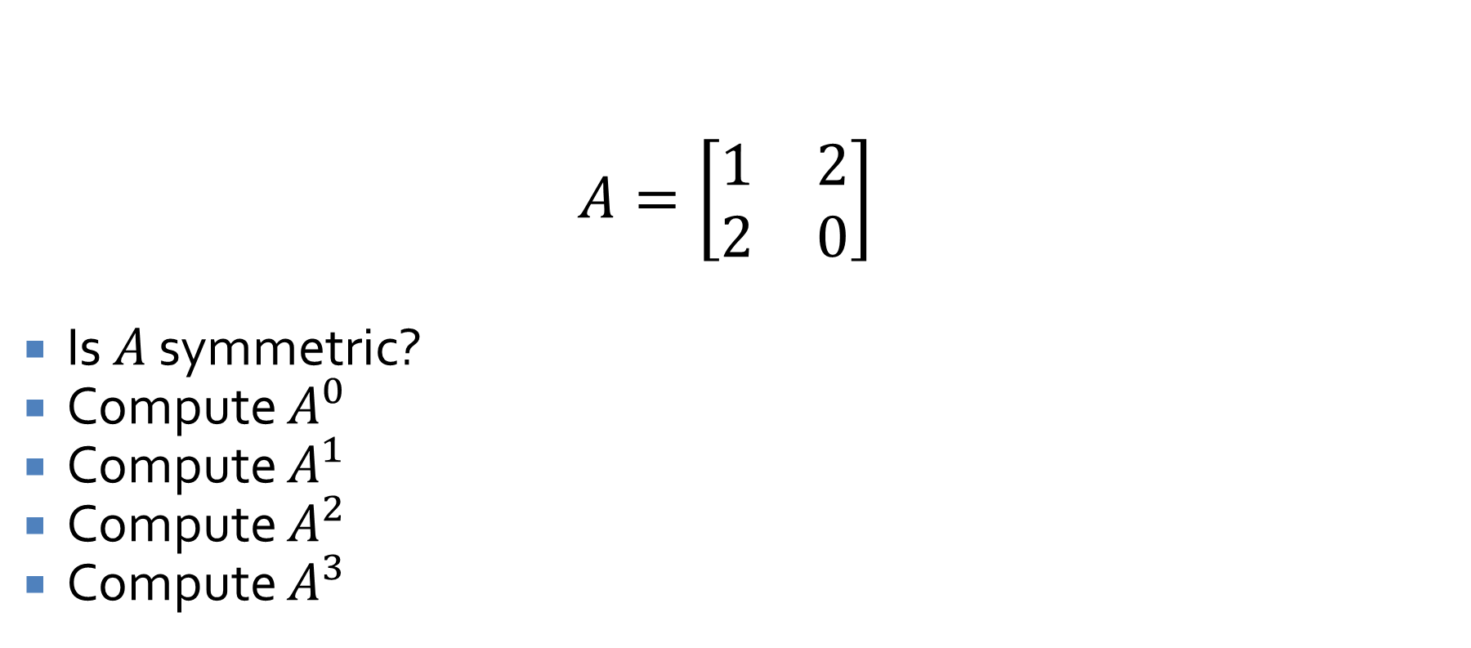
Finding powers of a matrix
$$A=\left[\begin{matrix}1 & 2 \\ 2 & 0\end{matrix}\right]$$
Is $A$ symmetric?
Compute $A^{0}$
Compute $A^{1}$
Compute $A^{2}$
Compute $A^{3}$

Slide 20
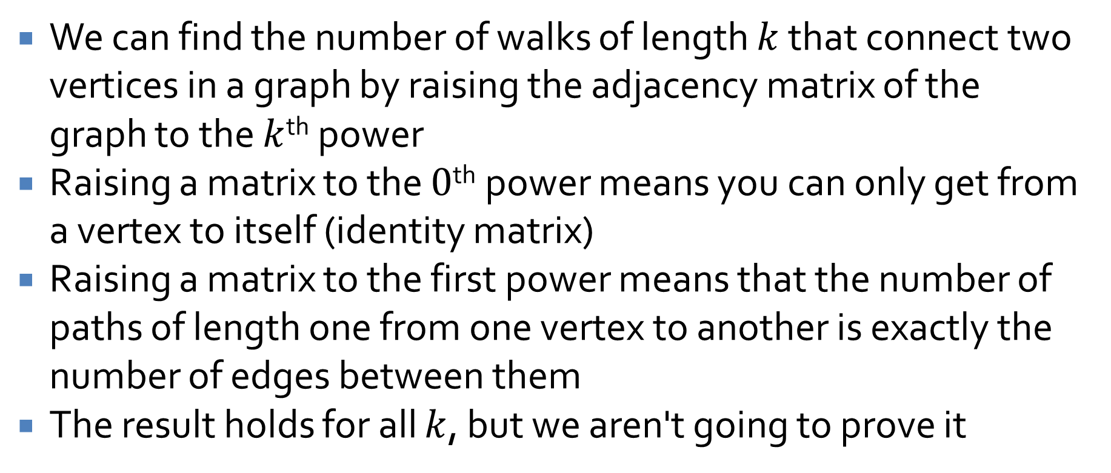
Matrix powers for graphs
We can find the number of walks of length $k$ that connect two vertices in a graph by raising the adjacency matrix of the graph to the $k$^{th} power
Raising a matrix to the $0$^{th} power means you can only get from a vertex to itself (identity matrix)
Raising a matrix to the first power means that the number of paths of length one from one vertex to another is exactly the number of edges between them
The result holds for all $k$, but we aren't going to prove it

Slide 21
Graph Isomorphism

Slide 22
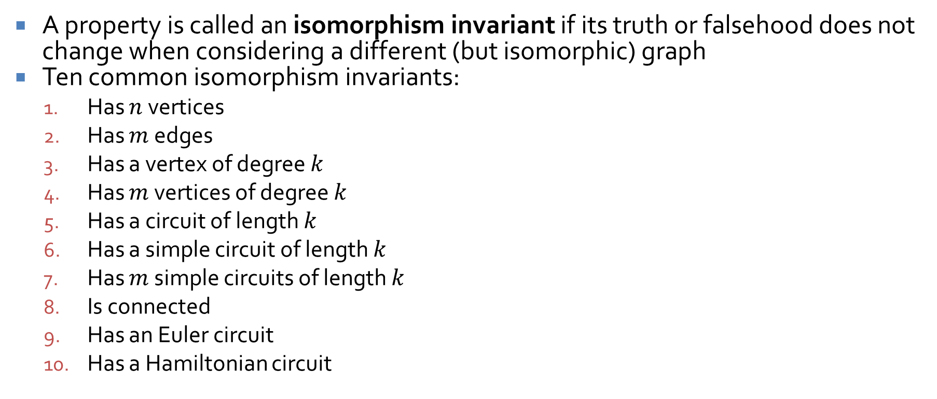
Isomorphism invariants
A property is called an isomorphism invariant if its truth or falsehood does not change when considering a different (but isomorphic) graph
Ten common isomorphism invariants:
Has $n$ vertices
Has $m$ edges
Has a vertex of degree $k$
Has $m$ vertices of degree $k$
Has a circuit of length $k$
Has a simple circuit of length $k$
Has $m$ simple circuits of length $k$
Is connected
Has an Euler circuit
Has a Hamiltonian circuit

Slide 23
Using invariants to disprove isomorphism
If any of the invariants have different values for two different graphs, those graphs are not isomorphic
Use the ten invariants given to show that the following pair of graphs is not isomorphic

Slide 24
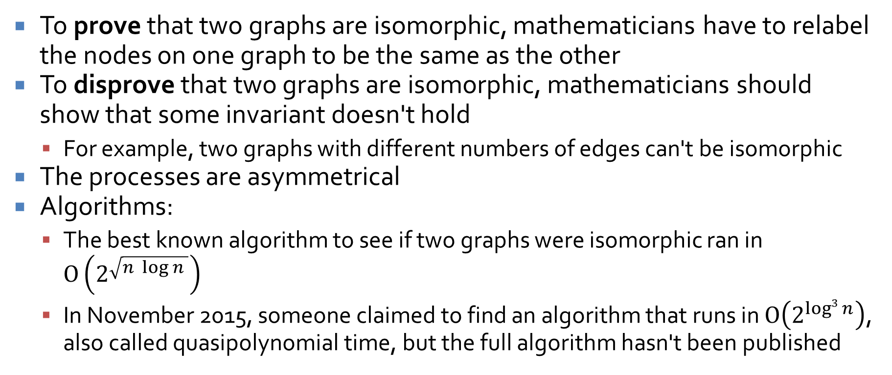
Proving isomorphism
To prove that two graphs are isomorphic, mathematicians have to relabel the nodes on one graph to be the same as the other
To disprove that two graphs are isomorphic, mathematicians should show that some invariant doesn't hold
For example, two graphs with different numbers of edges can't be isomorphic
The processes are asymmetrical
Algorithms:
The best known algorithm to see if two graphs were isomorphic ran in $O\left(2^{\sqrt{n \log{n} }}\right)$
In November 2015, someone claimed to find an algorithm that runs in $O\left(2^{log3{n}}\right)$, also called quasipolynomial time, but the full algorithm hasn't been published

Slide 25
Upcoming

Slide 26
Next time…
Trees
Rooted trees
Spanning trees and shortest paths

Slide 27
Reminders
Work on Assignment 5
Read 10.4, 10.5, and and 10.6
Prepare a three-sentence summary
Extra credit if you get called on

